Slide 1

TEMPLATE
Positioning vector exercise
This template helps you uncover the right combination of value propositions to position your product. For best results, use it after you've completed the "Best, Better, Only" exercise from section 4.3 of the book.

Slide 2
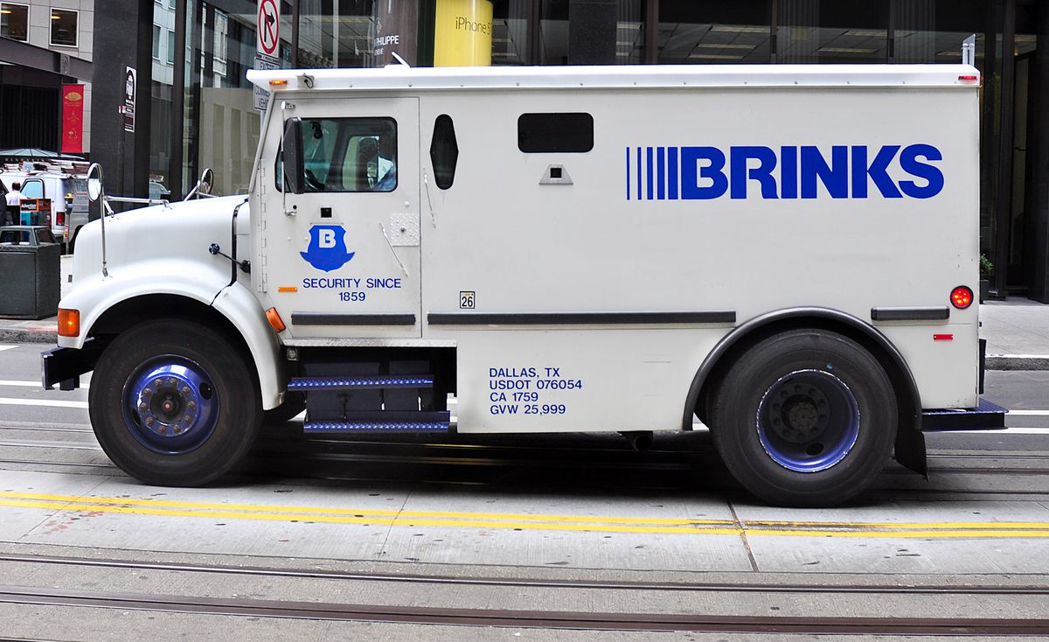
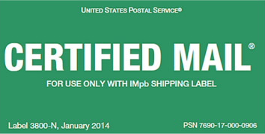





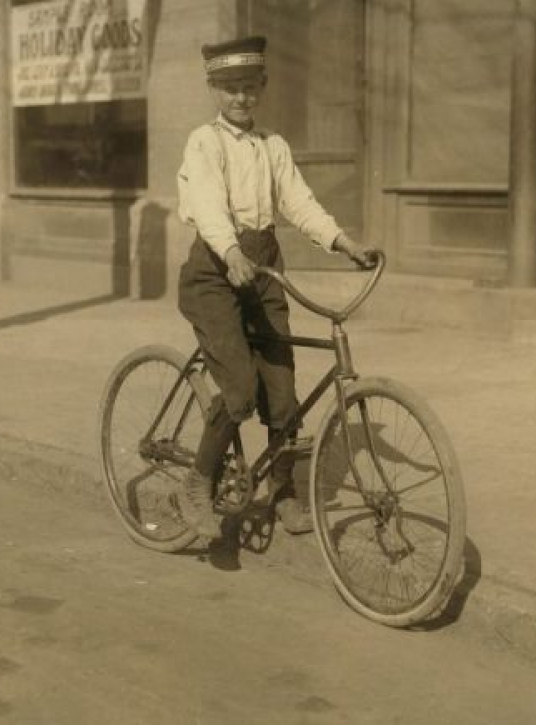
SAMPLE
Completed exercise
Use this slide as a reference for your own exercise. In this example, we’re considering the market from Brinks’ – private security & transportation company – point of view.
Our ideal customer profile (ICP) is primarily companies or high-profile people that need to transport valuable assets.
To set us apart from the competition, the two positioning vectors we chose were speed and security.
When used together, we set ourselves apart from the rest. These value proposition pillars provide the foundation for our positioning and messaging.
Security
Speed

Slide 3
TEMPLATE - MAKE A COPY
Scatterplot with dots and names
Change the placeholders – add your company and the names of your competitors.
Simple
Precise
Best for large data sets
Our company
Competitor 2
Competitor 4
Positioning vector 2
Competitor 1
Competitor 3
Positioning vector 1

Slide 4





TEMPLATE - MAKE A COPY
Scatterplot with competitor logos
Upload your competitors’ logos and plot them against yours.
Visually-focused
Best for small data sets
Positioning vector 2
Positioning vector 1

